Slide 1
Data Science with R Final Project - Bank Marketing
By: Navneet

Slide 2
1.
Dataset Info & Question

Slide 3
“Bank Marketing” from UC Irvine Machine Learning Repository
https://archive.ics.uci.edu/dataset/222/bank+marketing
Data collected from bank marketing campaigns. Goal is to classify if a client will subscribe (y = 1) or not (y = 0).
Features: age, job, marital, education, default, housing, loan, contact, day of week, duration, campaign, previous, previous outcome, employment variation rate, consumer price index, consumer confidence index, 3 month euribor rate, number employed, y
Duration is not used in model as it is data collected after a call, goal is to predict before calling

Slide 4
“Bank Marketing” from UC Irvine Machine Learning Repository (Continued)
Around 40,000 observations used
Because data was collected in marketing campaigns, some null/unknown values because of clients’ unwillingness to provide certain information
Data collected from 2008 to 2010
Important summary statistics:
High range in things like employment variation rate, consumer confidence index, and 3 month euribor rate because data collection began during Great Recession. Good because it allows us to analyze these variables’ relationship with output variable (y) better

Slide 5
“Bank Marketing” from UC Irvine Machine Learning Repository (Continued)
Low amount of “yes” values for the output variable (y). Makes data imbalanced, requires using class weights in random forest + sampling techniques (I used undersampling of the majority class)
Were some outliers for the campaign variable (mean was around 2.6 and 3rd quartile was 3 while max was 56), but shouldn’t matter too much because random forest is robust to outliers

Slide 6
2.
Exploratory Analysis

Slide 7
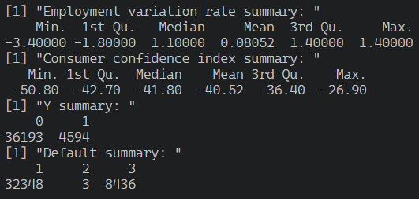
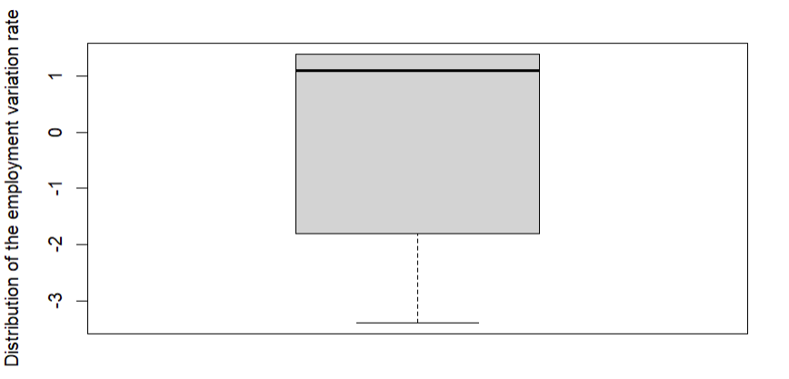
Exploratory Analysis
There is a large distribution of the employment variation rate. This is because of the fact that the data collection started in 2008, during the Great Recession. This is also the reason for the large variation and low values in the consumer confidence index. This is good as it allows us to further examine the effect of the economy on the y value. Y, as shown, is imbalanced, which was part of the decision of using sampling techniques and a random forest model. Finally, default had a very few amount of “yes” values. This is probably because these people did not want to disclose this private information. Even though they are outliers, the random forest model is robust to deal with this too.

Slide 8
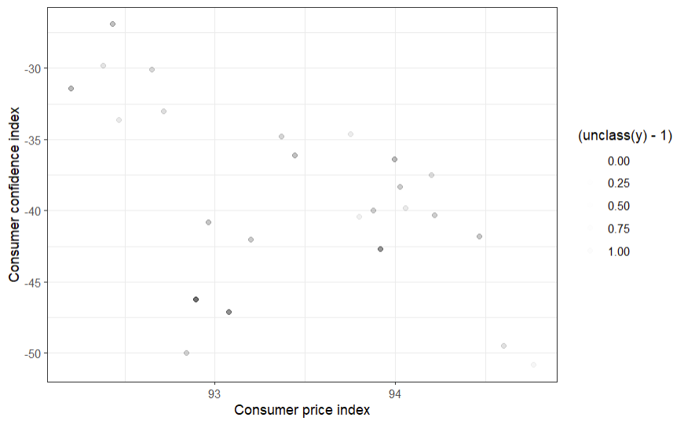
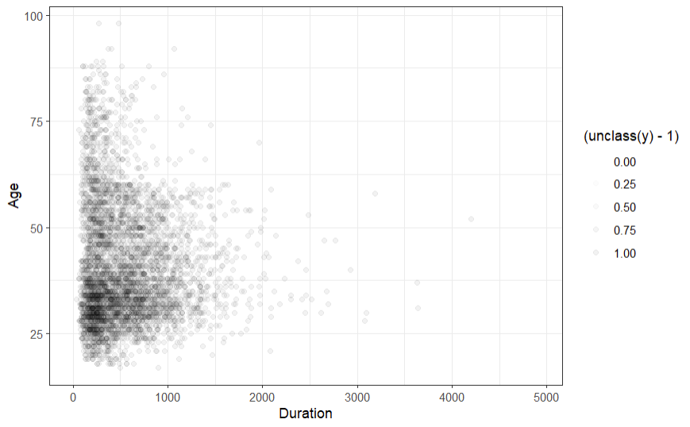
Exploratory Analysis
There seems to be a negative relationship between the consumer price index and confidence index. Furthermore, it seems that this relationship is positively tied to the “yes” outcome in y, meaning that a higher price index and lower confidence index means more “yes” in y.
There is a loosely negative relationship between age and duration of call. It also seems that most of the “yes” responses come from younger people.

Slide 9



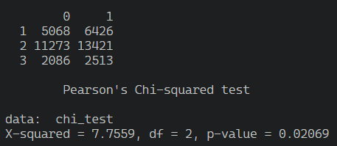
Exploratory Analysis: Chi-Squared Tests
It seems that the education (1 - 7) variable is positively correlated with y (0 - 1). As job increases, the ratio of 1 to 0 of y increases.
Previous outcome (-1 to 1, nonexistent, no, and yes) is also highly positively correlated with y.
The number of previous contacts (0 - 7) is also positively correlated with y.
The number of contacts during this campaign until a response was received (1 to 56 but only 13 shown) is negatively correlated to y, and as the number of contacts go on, the ratio of a value of 1 to 0 is reduced.
Marital state (1 to 3) and housing (0 to 1) seem to be slightly correlated, but the higher p-value indicates that it is probably due to random chance.

Slide 10
3.
Model

Slide 11
Model Choice
In the end, the model chosen was a random forest
At first, logistic regression was attempted using a GLM
However, all of the variables had a very low R^2 value (<0.25)
Seemed like the dataset was hard to work with
Instead, a tree model was attempted
Performance was better, so to improve, a random forest was implemented, and was used as the final model
Note: using duration did improve performance significantly, but was not used in the model for aforementioned reasons

Slide 12
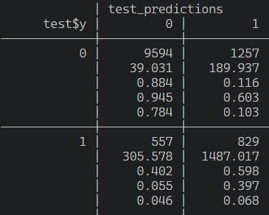
Model Choice (Continued)
Furthermore, very imbalanced dataset (~36,000 observations for y = 0, ~4,600 observations for y = 1)
Random forest is good for working with imbalance, over- and under-sampling used along with class weights
Confusion Matrix: The results of using the model to predict test$y.

Slide 13

Testing Multiple Models
As mentioned, first, a logistic regression model was attempted. However, as seen, the r-squared values for these models were very low. For example, the r-squared value for using duration to predict y (the highest r-squared value of any variable) was ~0.19.

Slide 14
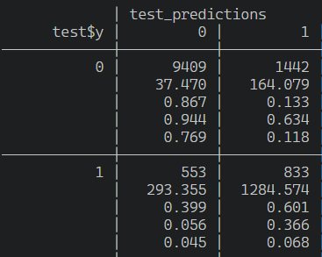
Testing Multiple Models (Continued)
The next model attempted is a tree model. This had pretty good results, comparable to the final model. However, I believed I could increase its performance with a random forest

Slide 15
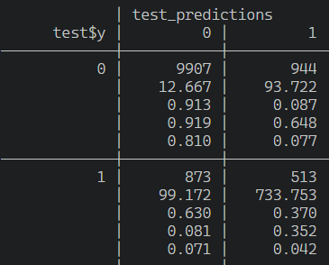
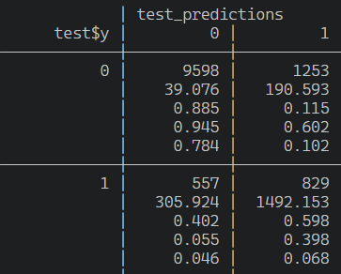
Testing Multiple Models (Continued)
The first random forest model performed similarly (maybe worse) than the tree model. However, After using a random forest and using k-folds cross validation to find tune the model with an mtry value of 2, the model was able to be slightly more effective than the tree model. Therefore, this tuned random forest was chosen as the final model.

Slide 16
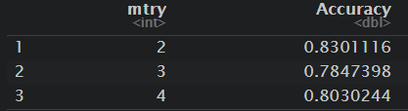
Tuning details of model
Because of the fact that random forests take a very long time to run (especially using repeated k-folds validation), I was not able to tune the model perfectly with multiple attempts. However, I was able to find that an mtry value of 2 worked the best for my model. Furthermore, I did multiple tests of editing the class weights, the sampling method (under, over, both, and ROSE), changing the train-test split, and other factors to decide upon the current model

Slide 17
Final Model Evaluation with Test Data
Metrics
Accuracy: ~85% (good considering duration was not used)
Kappa: ~0.40 (moderate)
F1 Score: ~0.91 (very good score, indicates high performance for model)
Precision: ~0.95 (this describes the model’s ability to recognize only relevant points and not misclassify irrelevant ones, very high and good score)
Recall: ~0.88 (describes the model’s ability to recognize all of the relevant points, a little lower but still good)
AUC: ~0.78 (explained on next slide)

Slide 18
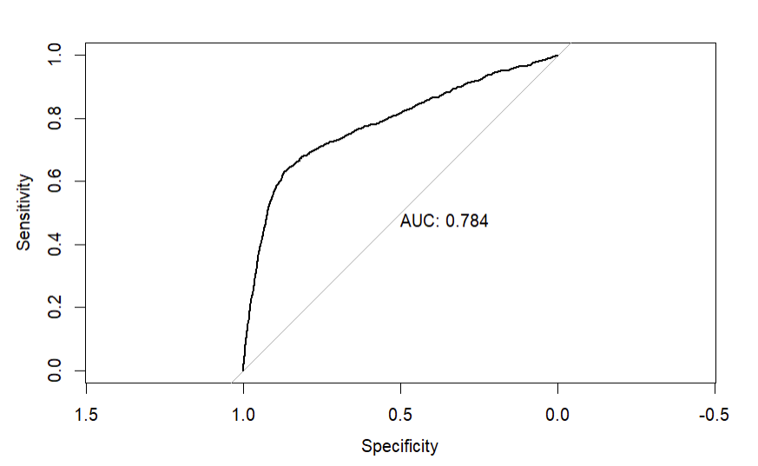
Model Evaluation with Test Data (Continued)
Using the model’s probability predictions instead of its classification predictions, we can construct an ROC-AUC curve. This curve gives us a AUC value of around 0.78, which is considered good and means the model is not making random guesses and is performing acceptably.

Slide 19
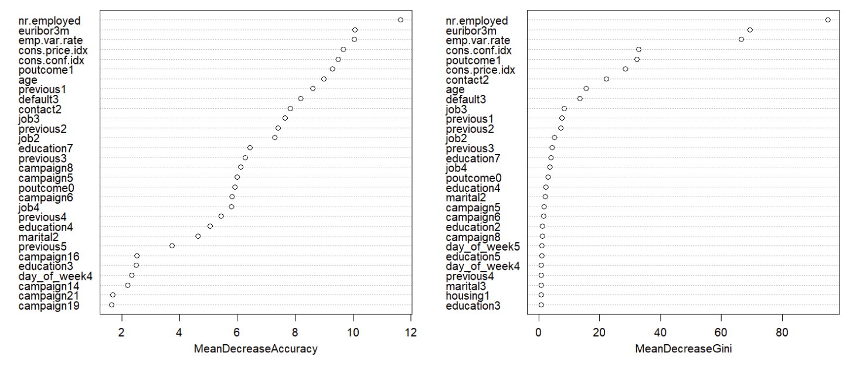
Variable Importance: The variable importance plots indicates that the most important variables include number employed, 3-month euribor rate, employment variation rate, consumer price and confidence index, and the previous outcome. This might mean that the most important variables in predicting a possible client are not demographics about the client, but information about the current state of the economy or company. However, the model also indicates that the outcome of contacting a client previously, the age of a client, and the client’s job and education are also important features to analyze, along with others.

Slide 20
4.
Final Results and Conclusion

Slide 21
Results/Conclusions
It is clear that a bank’s marketing success can benefit from several factors. First, it is clear that the economy is a big indicator of marketing success for banks. Some of the most important variables in the model included the 3-month euribor interest rate, the employment variation rate, the consumer confidence index, and the consumer price index. These are all indicators of the economy and point towards that being a big factor. However, there are also many variables in the control of banks for them to improve their marketing. For example, it is evident that there is a positive relationship between marketing success and the number of employees a bank has. The number of employees may affect how the bank is viewed in terms of prestige. Also, it is evident that clients contacted in a previous campaign and those that are employed have a higher chance of subscribing. However, the most important thing may be conducting marketing campaigns at a time with stability in the economy economy and higher interest rates.

